Slide 1
Artificial Intelligence and Machine Learning
Spam SMS Detection
Presentation by :
Aryan Sharma 2210990179
Aryan Sonkar 2210990182

Slide 2
Index
Introduction
Objective
Types
Challenges
Machine Learning algorithms
Python Libraries
Case Studies
Graphs
Conclusion
Reference

Slide 3

Introduction
SPAM SMS Detection :
To detect whether the meassages are spam or not

Slide 4
Objective
The primary objective of spam SMS detection is to mitigate the disruptive impact of unsolicited text messages on users' mobile communication experience. By accurately identifying and filtering out spam, detection systems aim to enhance user privacy, security, and trust in mobile networks.
These systems strive to differentiate between legitimate messages and spam, thereby minimizing the risk of users falling victim to phishing scams, fraudulent schemes, or other malicious activities propagated through SMS.
Additionally, spam SMS detection seeks to optimize network resources and operational efficiency by reducing the volume of unwanted messages traversing mobile networks
Ultimately, the objective of spam SMS detection is to enhance user satisfaction, privacy, and security within mobile communication networks.

Slide 5
Types of Spam SMS
Phishing Scams: Messages disguised as legitimate communications from trusted entities, such as banks, government agencies, or reputable companies.
Fraudulent Schemes: Messages offering false promises of financial gains, lottery winnings, or employment opportunities
Malware Distribution: Messages containing links or attachments that, when clicked or opened, download malicious software onto the recipient's device, compromising security and privacy.
Spoofed Messages: Messages that impersonate legitimate senders or institutions, using fake sender IDs or spoofed phone numbers to deceive recipients into believing the message is from a trusted source.
.

Slide 6
Challenges
Evolving Tactics: Spammers continuously adapt their techniques to evade detection, making it challenging for detection systems to keep up with new spamming tactics and patterns.
Variability in Content: Spam SMS can vary widely in content, ranging from advertisements and promotions to phishing scams and malware distribution.
Sender Spoofing: Spammers often spoof sender information or use fake sender IDs to make spam SMS appear as if they originate from trusted sources, making it difficult to identify and filter out fraudulent messages.
Volume and Velocity: The sheer volume of spam SMS sent daily, combined with the rapid pace at which they are distributed, overwhelms detection systems
User Engagement: Some users may inadvertently engage with spam SMS by clicking on links or responding to messages, leading to further propagation of spam and complicating detection efforts.

Slide 7

Machine learning algorithms
Support Vector Machines (SVM): SVM classifiers are powerful supervised learning models that excel at separating data into different classes by finding the optimal hyperplane.
Decision Trees: Decision tree classifiers recursively partition the feature space into subsets based on feature values, resulting in a tree-like structure of decision rules.
Random Forests: Random forests are ensemble learning methods that combine multiple decision trees to improve classification accuracy and robustness.

Slide 8

Python Libraries
Natural Language Toolkit (NLTK): NLTK is a captivating library for natural language processing tasks, providing a plethora of tools for text tokenization, stemming, and stopwords removal.
Scikit-learn: Scikit-learn offers a labyrinth of machine learning algorithms and utilities for classification tasks, including Naive Bayes, SVM, decision trees, and ensemble methods
Pandas: Pandas is an enigmatic library for data manipulation and analysis, offering powerful tools for handling tabular data structures like DataFrames.

Slide 9

Case Studies
Telecommunication Service Provider: A telecommunications company deploys a spam SMS detection system to protect its customers from unsolicited messages.
Financial Institution: A financial institution implements a spam SMS detection system to safeguard its customers from phishing attacks and fraudulent schemes.
Mobile Application: A mobile messaging application integrates a spam SMS detection feature to enhance user experience and security. By leveraging natural language processing

Slide 10
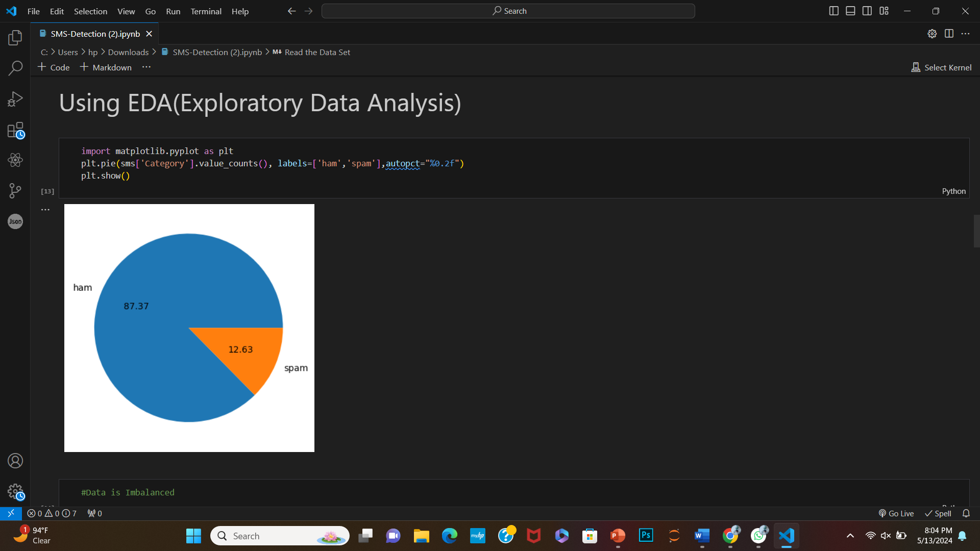
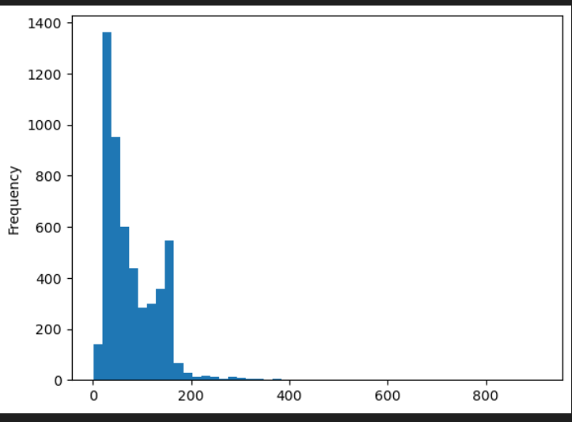
Graphs

Slide 11
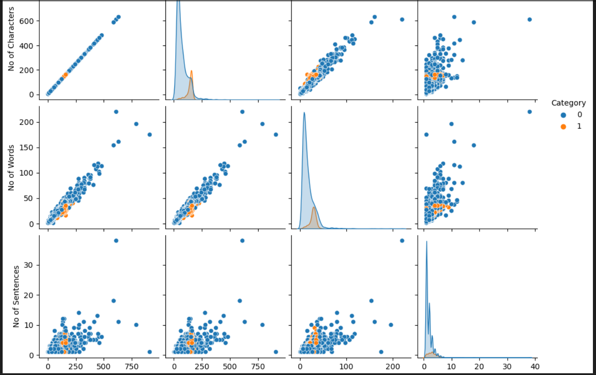
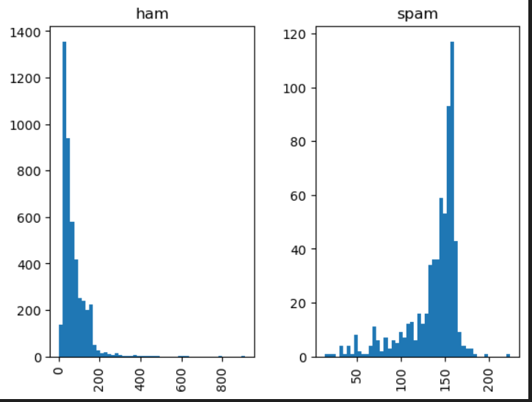
Graphs

Slide 12

Conclusion
In conclusion, spam SMS detection stands as a pivotal mechanism in safeguarding users' privacy, security, and overall communication experience in the mobile domain.
Through the integration of advanced machine learning algorithms, natural language processing techniques, and behavioral analysis,.

Slide 13


